Slide 1
Data Mining Anomaly Detection
Lecture Notes for Chapter 10
Introduction to Data Mining
by
Tan, Steinbach, Kumar
© Tan,Steinbach, Kumar Introduction to Data Mining 4/18/2004 1

Slide 2

What are Anomalies?
Anomaly is a pattern in the data that does not conform to the expected behavior
Also referred to as outliers, exceptions, peculiarities, surprise, etc.
Anomalies translate to significant (often critical) real life entities
Cyber intrusions
Credit card fraud
Fault detection
Sports statistics
Etc.

Slide 3
Effect of Outliers
http://www.statsoft.com/textbook/basic-statistics/#Correlationsd

Slide 4
Simple Example
N₁ and N₂ are regions of normal behavior
Points o₁ and o₂ are anomalies
Points in region O₃ are anomalies
Y
N₁
o₁
O₃
o₂
N₂
X

Slide 5
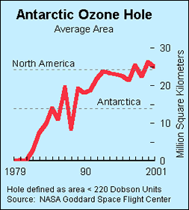
Importance of Anomaly Detection
Ozone Depletion History
In 1985 three researchers (Farman, Gardinar and Shanklin) were puzzled by data gathered by the British Antarctic Survey showing that ozone levels for Antarctica had dropped 10% below normal levels
Why did the Nimbus 7 satellite, which had instruments aboard for recording ozone levels, not record similarly low ozone concentrations?
The ozone concentrations recorded by the satellite were so low they were being treated as outliers by a computer program and discarded!
Sources: http://exploringdata.cqu.edu.au/ozone.html http://www.epa.gov/ozone/science/hole/size.html

Slide 6
Related problems
Rare Class Mining
Chance discovery
Novelty Detection
Exception Mining
Noise Removal
Black Swan*
* N. Talleb, The Black Swan: The Impact of the Highly Probable?, 2007

Slide 7
Anomaly Detection (General Scenario)
Supervised scenario
In some applications, training data with normal and abnormal data objects are provided
Often, the classification problem is highly unbalanced
Semi-supervised Scenario
In some applications, only training data for the normal class(es) are provided
Unsupervised Scenario
In most applications there are no training data available

Slide 8
Anomaly Detection
Working assumption:
There are considerably more “normal” observations than “abnormal” observations (outliers/anomalies) in the data
Challenges:
Unknown number of outliers in the data
Often: finding needle in a haystack
In unsupervised scenario, validation can be quite challenging (just like for clustering)

Slide 9
Key Challenges
Availability of labeled data for training/validation
Finding representative data is challenging
The boundary between normal and outlying behavior is often not precise
Various outlier definitions in different application domains
Normal/anomalous behavior might evolve

Slide 10
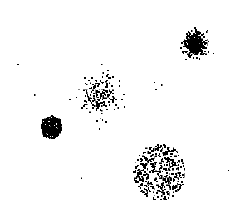
Anomaly Detection Schemes
General Steps
Build a profile of the “normal” behavior
Profile can be patterns or summary statistics for the overall population
Use the “normal” profile to detect anomalies
Anomalies are observations whose characteristics differ significantly from the normal profile
Types of anomaly detection schemes
Graphical & Statistical-based
Distance-based
Cluster-based

Slide 11
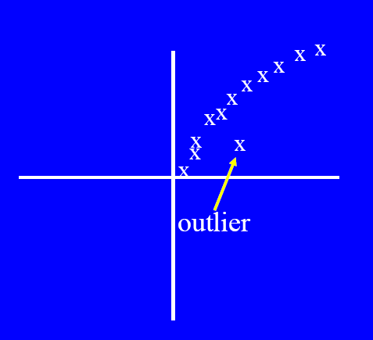
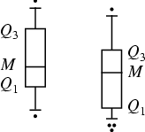
Graphical Approaches
Boxplot (1-D), Scatter plot (2-D,3-D)
Limitations
Time consuming
Subjective

Slide 12
Ggobi Presentation
http://www.ggobi.org/

Slide 13
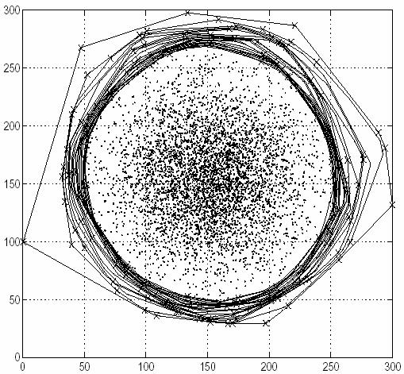
Convex Hull Method [Tukey 1977]
Extreme points are assumed to be outliers
Use convex hull method to detect extreme values
Basic assumption:
Outliers are located at the border of the data space

Slide 14
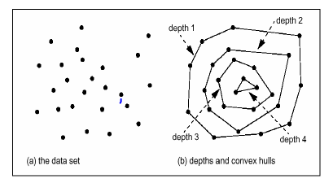
Convex Hull Method [Tukey 1977]
Points on the convex hull of the full data have depth = 1
Points on the convex after removing the points with depth = 1 have depth = 2
…
Points having a depth ≤ k are reported as outliers

Slide 15
Complexity of Convex Hull Algorithms
Lower bound: Ω(nlogn)
Optimal output sensitive algorithm: O(n log h), where h is the number of points in the hull
Many variations: randomized, online, …

Slide 16
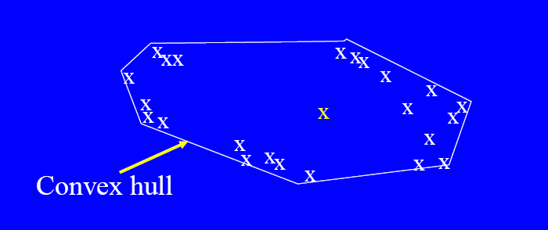
Problem
What if the outlier occurs in the middle of the data?

Slide 17
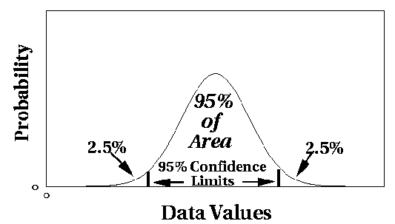
Statistical Approaches
Assume a parametric model describing the distribution of the data (e.g., normal distribution)
Apply a statistical test that depends on
Data distribution
Parameter of distribution (e.g., mean, variance)
Number of expected outliers (confidence limit)

Slide 18
Statistical Test
Probability density function of a multivariate normal distribution: f(x)=(2π)^{-n/2} (det[Σ])^{-1/2} exp[-(x-μ)^{T}Σ⁻¹(x-μ)/2]])^{-1/2}
μ is the mean value of all points (usually data is normalized such that μ=0)
Σ is the covariance matrix from the mean

Slide 19
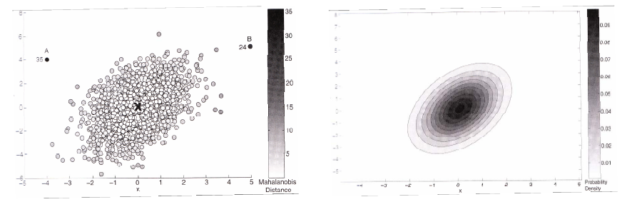
Statistical Test
MDist(x, μ):=(x-μ)^{T}Σ⁻¹(x-μ) is the Mahalanobis distance of point x to μ
MDist follows a χ2-distribution with d degrees of freedom (d = data dimensionality)
Label all points x, with MDist(x,μ) > χ2(0,975) [≈ 3.σ] as outliers

Slide 20
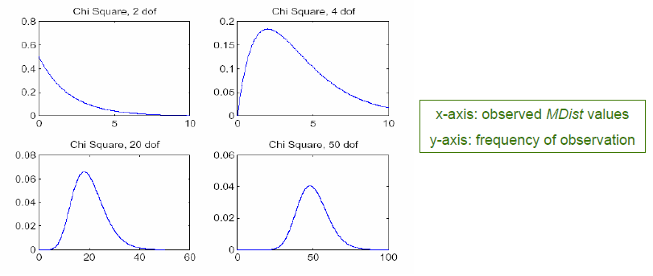
Problem
Curse of dimensionality: the larger the degree of freedom, the more similar the MDist values for all points.

Slide 21
Grubbs’ Test
Detect outliers in univariate data
Assume data comes from normal distribution
Detects one outlier at a time, remove the outlier, and repeat
H₀: There is no outlier in data
H_{A}: There is at least one outlier
Grubbs’ test statistic:
Reject H₀ if:

Slide 22
Statistical-based – Likelihood Approach
Assume the data set D contains samples from a mixture of two probability distributions:
M (majority distribution)
A (anomalous distribution)
General Approach:
Initially, assume all the data points belong to M
Let L_{t}(D) be the log likelihood of D at time t
For each point x_{t} that belongs to M, move it to A
Let L_{t+1} (D) be the new log likelihood.
Compute the difference, Δ = L_{t}(D) – L_{t+1} (D)
If Δ > c (some threshold), then x_{t} is declared as an anomaly and moved permanently from M to A

Slide 23
Statistical-based – Likelihood Approach
Data distribution, D = (1 – λ) M + λ A
M is a probability distribution estimated from data
Can be based on any modeling method (naïve Bayes, maximum entropy, etc)
A is initially assumed to be uniform distribution
Likelihood at time t:

Slide 24
Limitations of Statistical Approaches
Most of the tests are for a single attribute
In many cases, data distribution may not be known
For high dimensional data, it may be difficult to estimate the true distribution

Slide 25
Distance-based Approaches
Data is represented as a vector of features
Three major approaches
Nearest-neighbor based
Density based
Clustering based

Slide 26
Nearest-Neighbor Based Approach
Approach:
Compute the distance between every pair of data points
There are various ways to define outliers:
Data points for which there are fewer than p neighboring points within a distance D
The top n data points whose distance to the kth nearest neighbor is greatest
The top n data points whose average distance to the k nearest neighbors is greatest

Slide 27
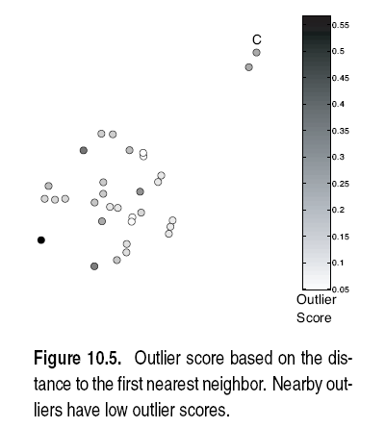
Proximity-Based: Distance to kNN

Slide 28
Proximity-Based: Distance to kNN

Slide 29
Proximity-Based: Distance to kNN

Slide 30
Density-Based Approaches
General idea:
Compare density around a point with density around its local neighbors
Relative density of a point compared to its neighbors is used as an outlier score
Approaches differ in how to estimate density
Basic assumption:
Density around a normal data object is similar to the density around its neighbors
Density around an outlier is considerably different to the density around its neighbors

Slide 31
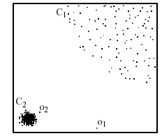
Local Outlier Factor (LOF)
For each point, compute the density of its local neighborhood
Compute local outlier factor (LOF) of a sample p as the average of the ratios of the density of sample p and the density of its nearest neighbors
Outliers are points with largest LOF value
In the NN approach, p₂ is not considered as outlier, while LOF approach find both p₁ and p₂ as outliers
p₂
×
p₁
×

Slide 32
5NN-Based Outlier

Slide 33
Local Outlier Factor (LOF)

Slide 34
Outliers in Lower Dimensional Projection
In high-dimensional space, data is sparse and notion of proximity becomes meaningless
Every point is an almost equally good outlier from the perspective of proximity-based definitions
Lower-dimensional projection methods
A point is an outlier if in some lower dimensional projection, it is present in a local region of abnormally low density

Slide 35

Outliers in Lower Dimensional Projection
Divide each attribute into φ equal-depth intervals
Each interval contains a fraction f = 1/φ of the records
Consider a k-dimensional cube created by picking grid ranges from k different dimensions
If attributes are independent, we expect region to contain a fraction f^{k} of the records
If there are N points, we can measure sparsity of a cube D as:
Negative sparsity indicates cube contains smaller number of points than expected

Slide 36
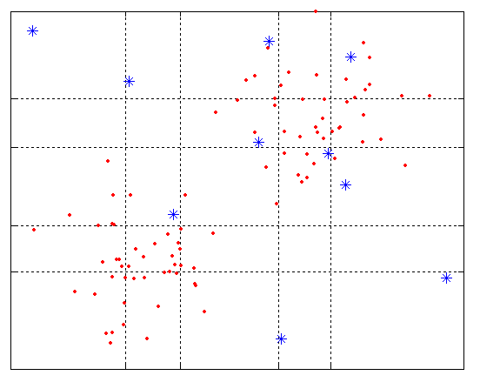
Example
N=100, φ = 5, f = 1/5 = 0.2, N × f² = 4

Slide 37

Clustering-Based
Basic idea:
Cluster the data into groups of different density
Points in small clusters are outlier candidates
Compute the distance between outlier candidates and non-candidates.
If candidates are far from all other non-candidates, they are outliers

Slide 38
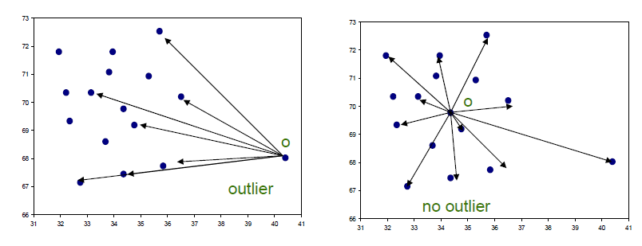
Approach for High-Dimensional Data
ABOD – angle-based outlier degree [Kriegel et al. 2008]
Rational:
Angles are more stable than distances in high dimensional spaces
Point o is an outlier if most other points are located in similar directions
Point o is no outlier if many other points are located in varying directions

Slide 39
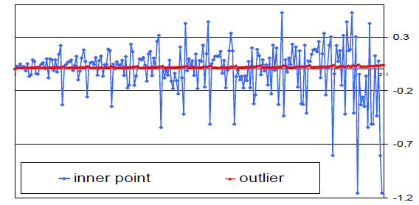
Approach for High-Dimensional Data
ABOD – Method:
Consider for a given point p the angle between
px and py for any two x,y from the database
Consider the spectrum of all these angles
The broadness of this spectrum is a score for the outlierness of a point

Slide 40
Summary
Different methods are based on different assumptions
Different methods provide different types of output (labeling/scoring)
Outliers might be global or local

Slide 41

Thank You!

